Slide 1
SBE Kent Limited Unit 1 The Mill Horton Road South Darenth Kent DA4 9LW T: 01322 476 350 W:www.sbekentltd.co.uk
2021/2022 Project Portfolio

Slide 2
SBE Kent Limited history
SBE Kent LIMITED was established in 2010 by our directors Stephen Stanton and Stef Buscaglia as a Mechanical and Electrical installation company working for a handful of clients in both the building industry and the end user market providing maintenance packages and as annual service providers.
SBE have carried out work in various sectors of the industry such as Commercial installations, Pharmaceutical and Public sector areas such as Dulwich Prep School, Pembury NHS staff accommodation and most recently East Surry college.
We Pride ourselves on being a company who constantly strive to deliver project on time and withing budget but more importantly always working to the highest of standard 100% off the time no matter the size or value of the project.
We believe in the constant training and investment into our operatives will not only help them to progress further along their own personal journey through the construction industry but will also befit SBE with continual learning and adapting to makes sure we are delivering at the highest of standards at all times.

Slide 3
SBE ORGANOGRAM
Stephen Stanton
Director
Stef Buscaglia
Director
Anthony Stanton
Project Director
Antony Miller
Qualifying Manager
Michael Buscaglia
Junior Engineer
Luke Ellis
M+E Site Supervisor
Theresa Brady
Office Manager
SBE Site Team

Slide 4
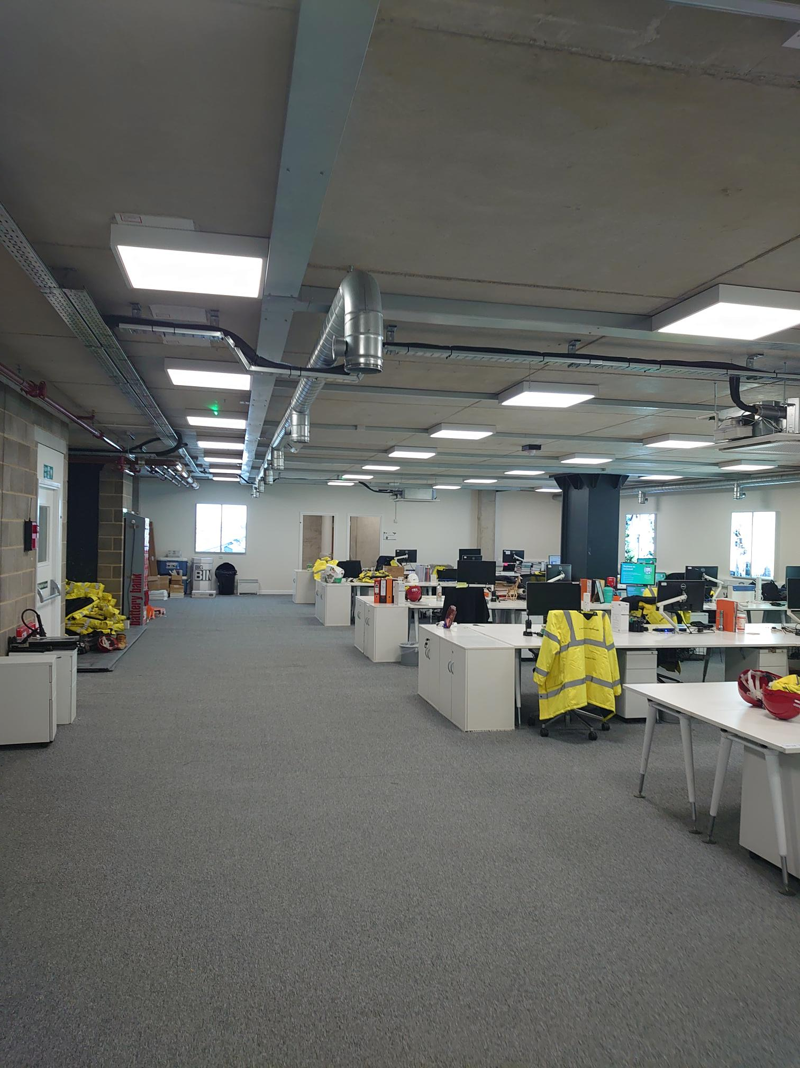
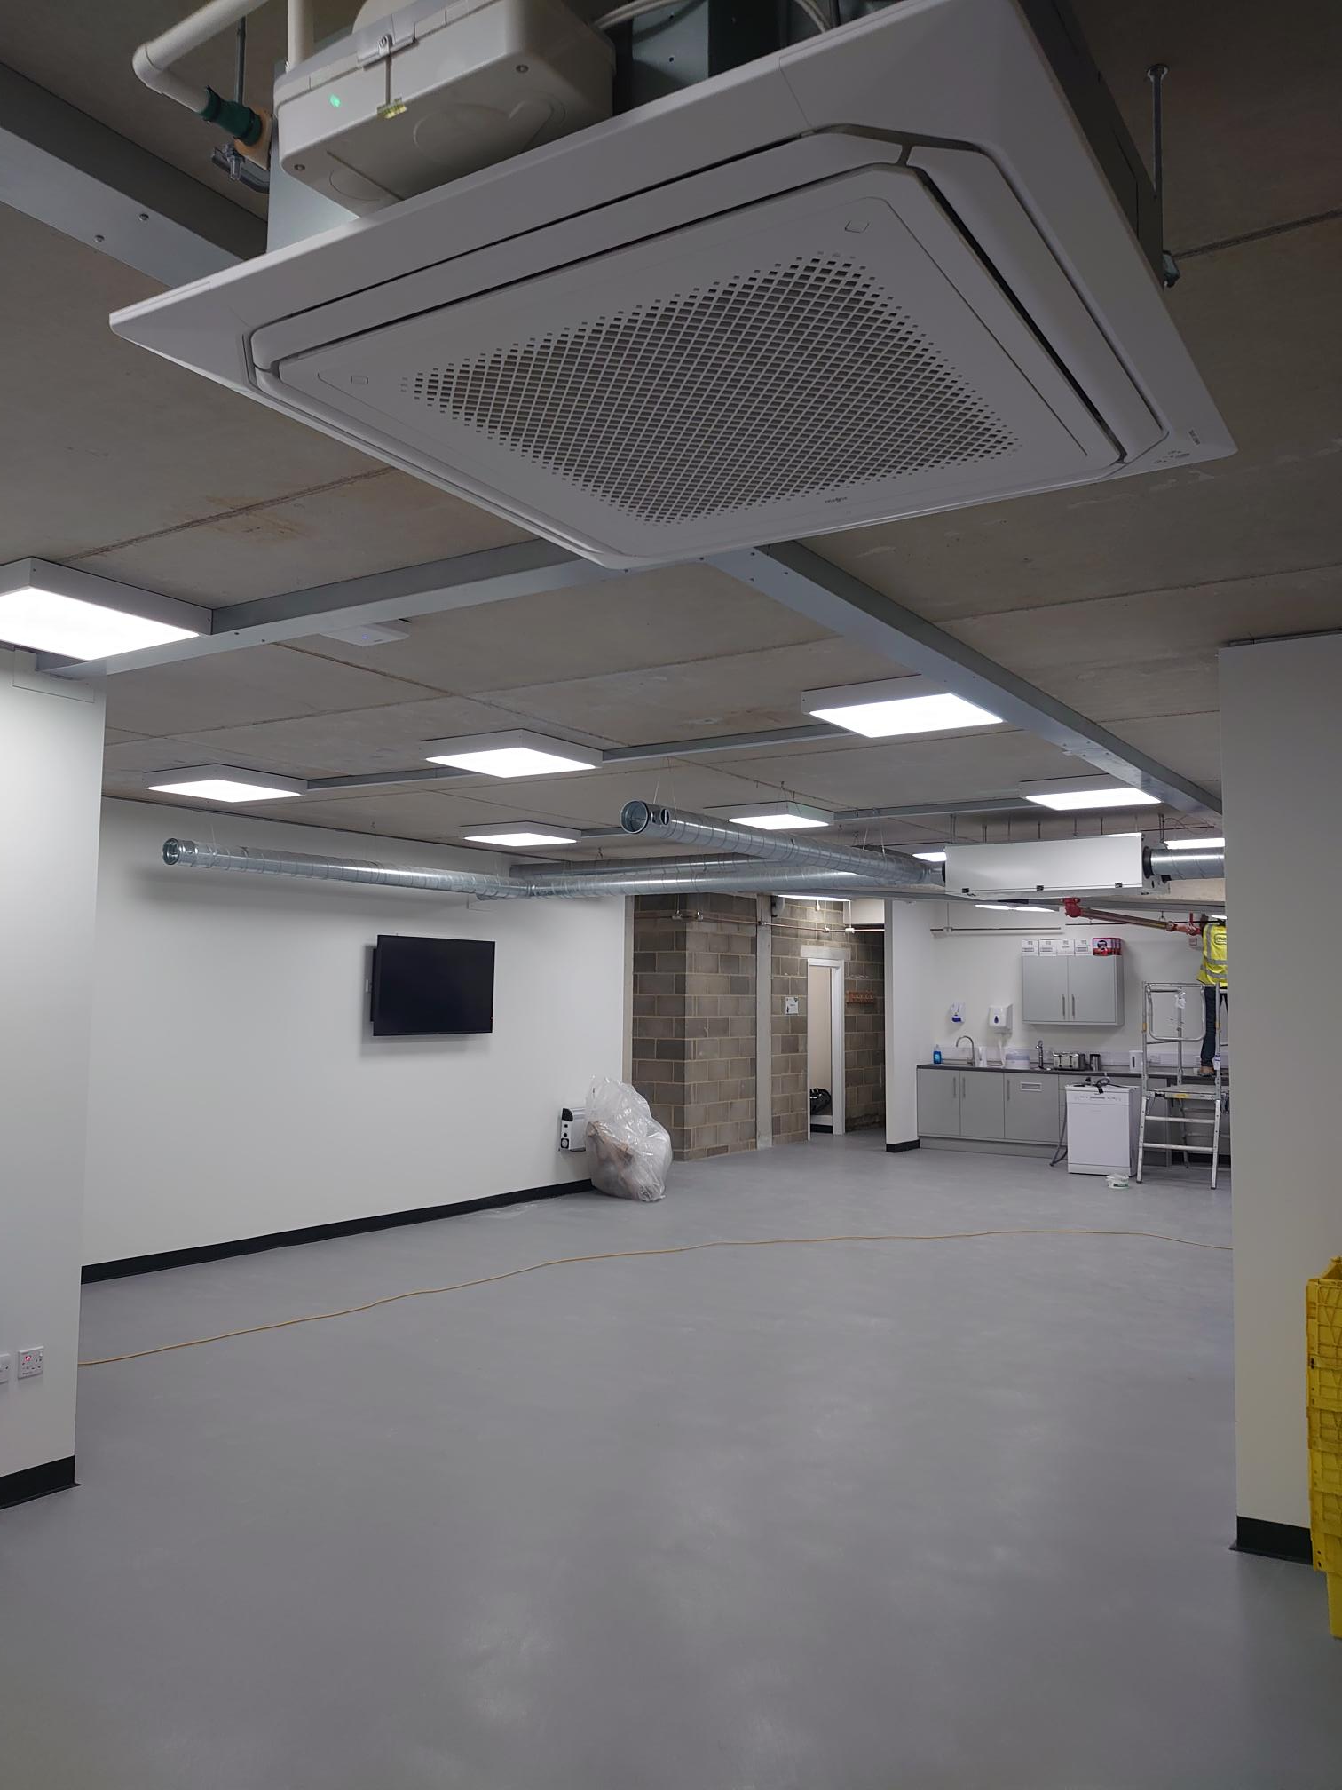
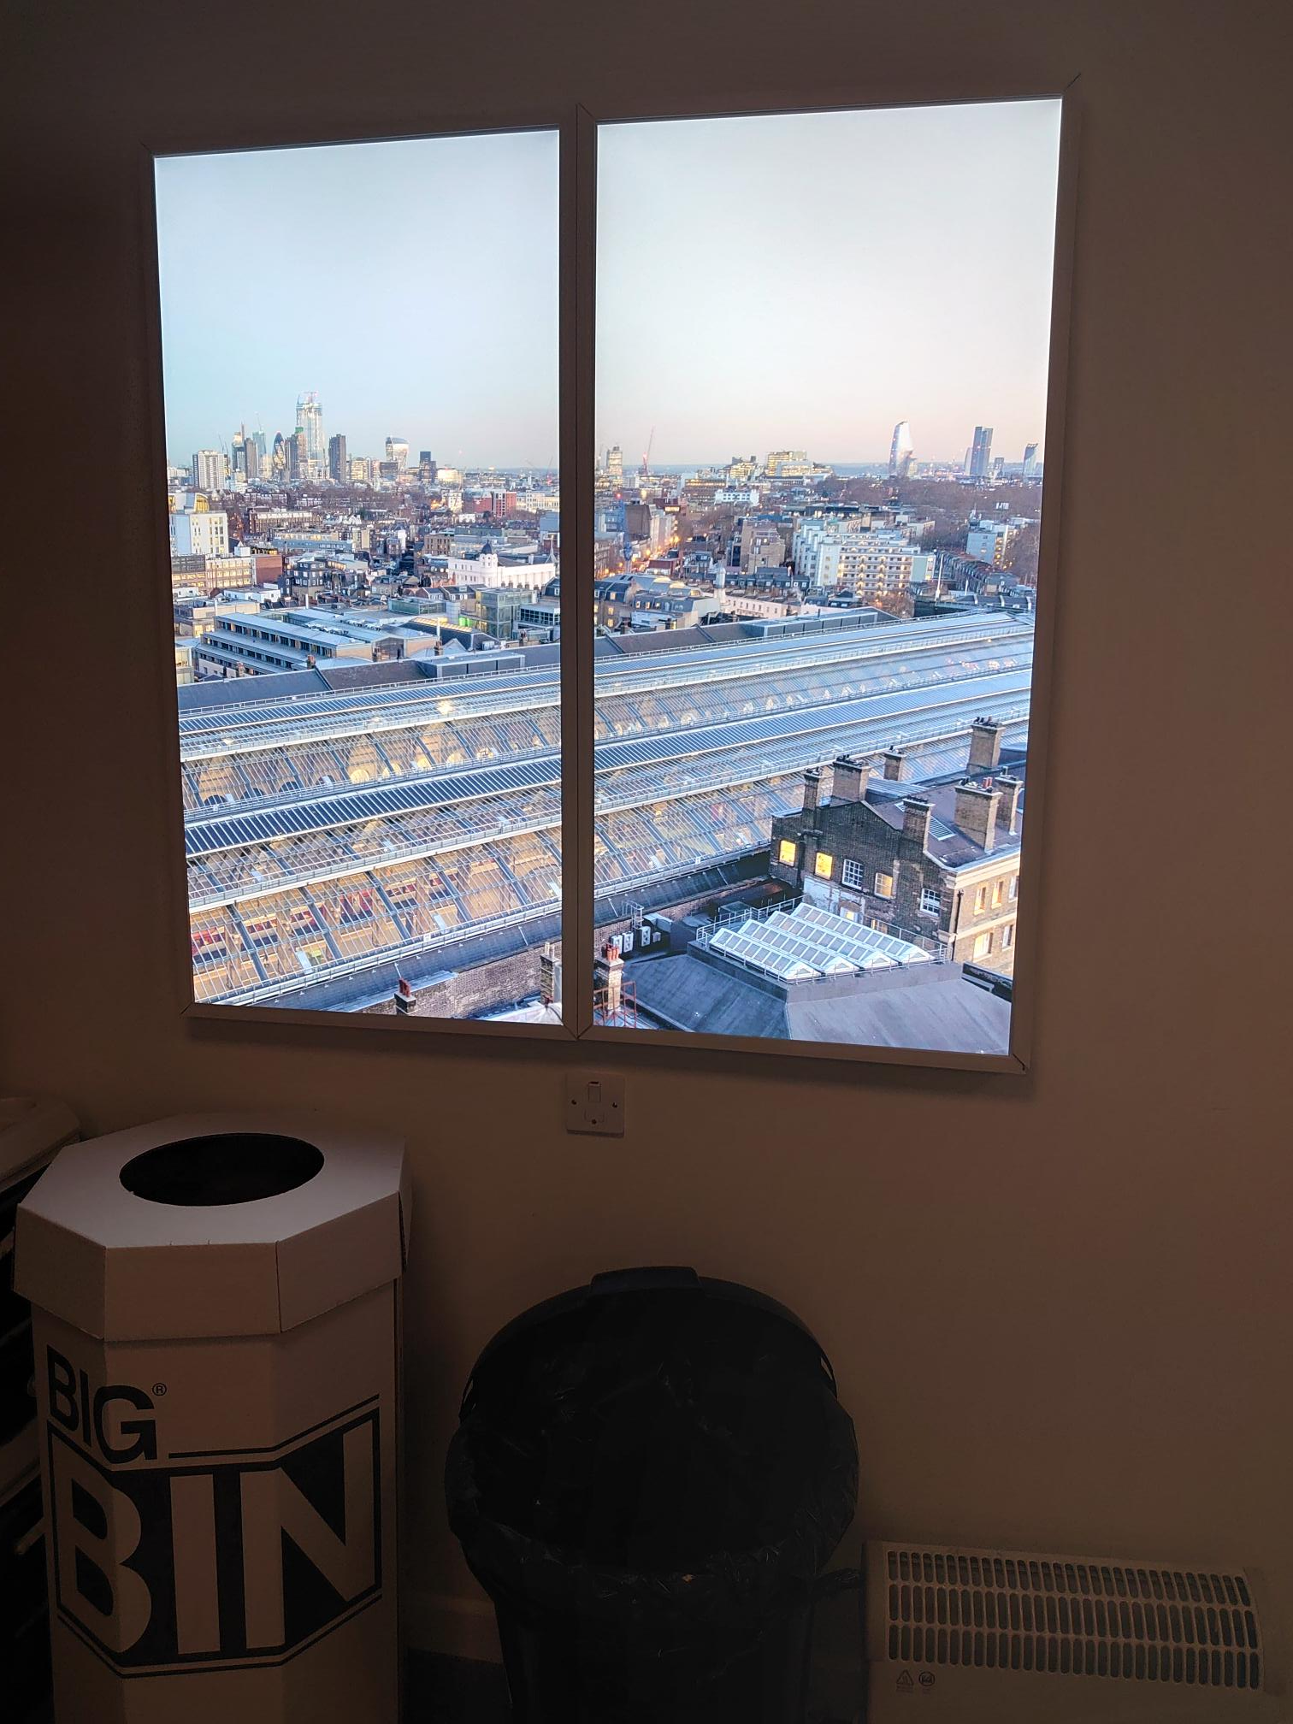
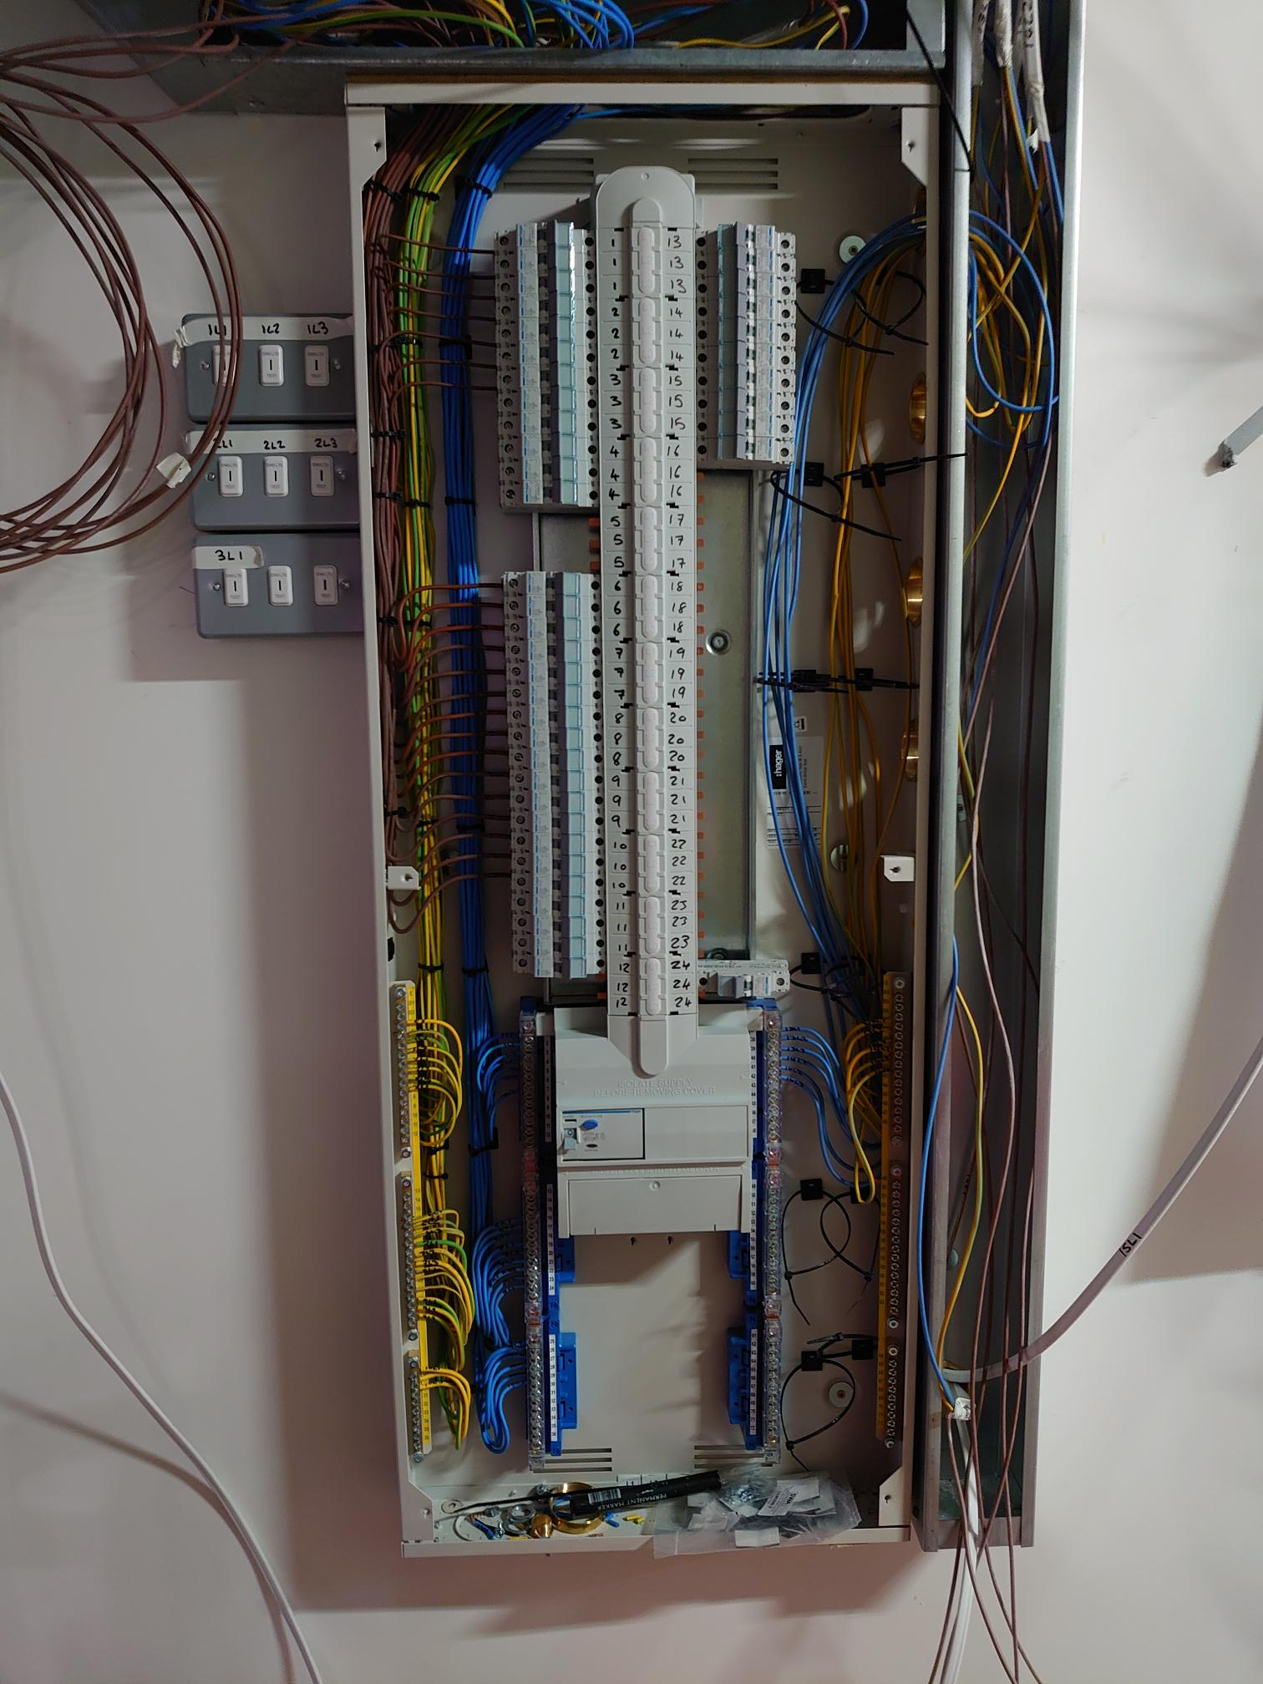
Recent projects: Google Temporary welfare Kings cross kgx1 M+e Package

Slide 5
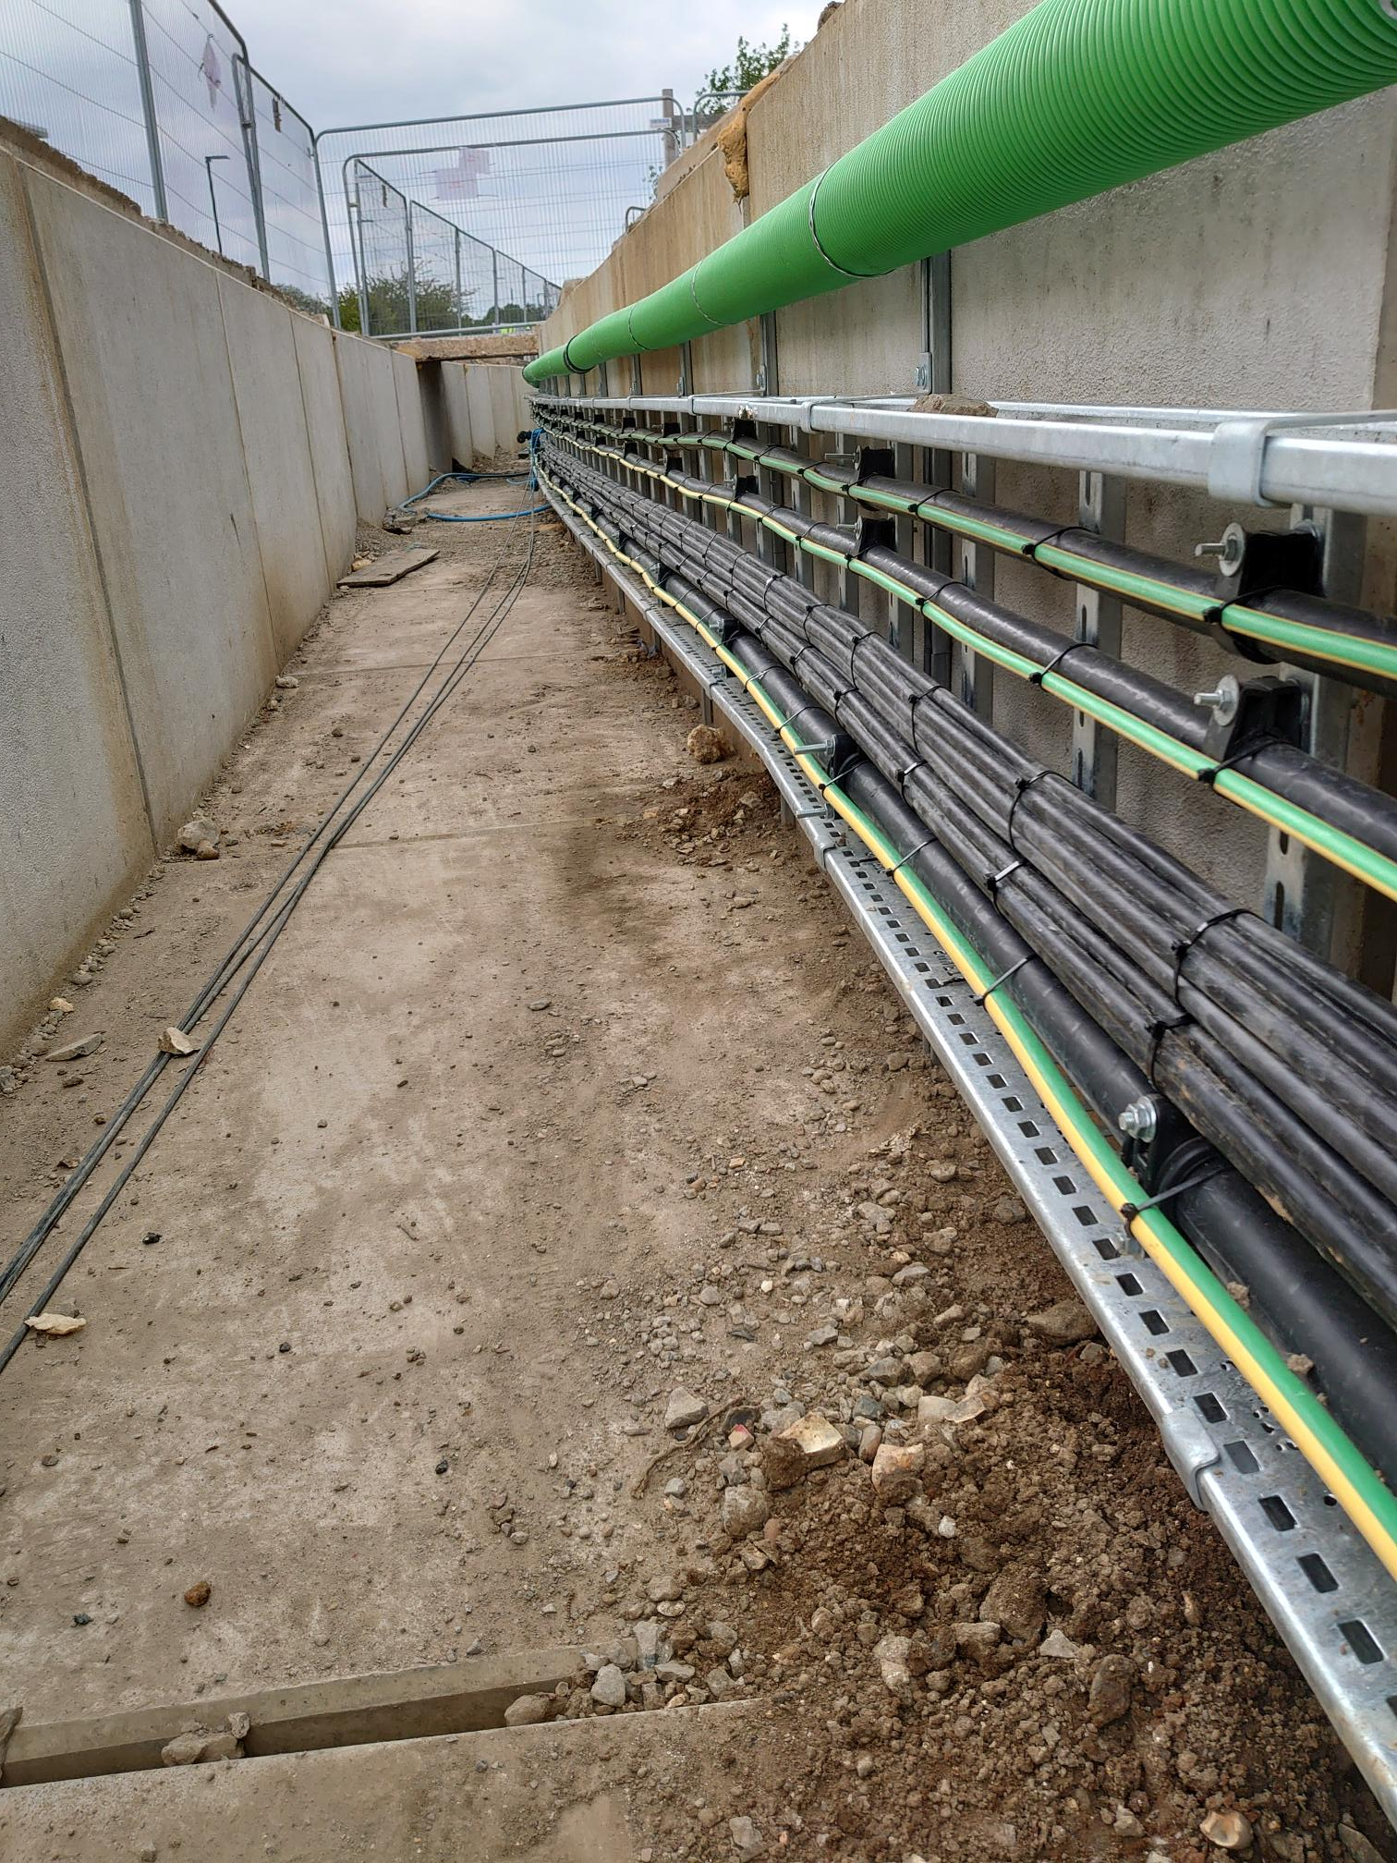
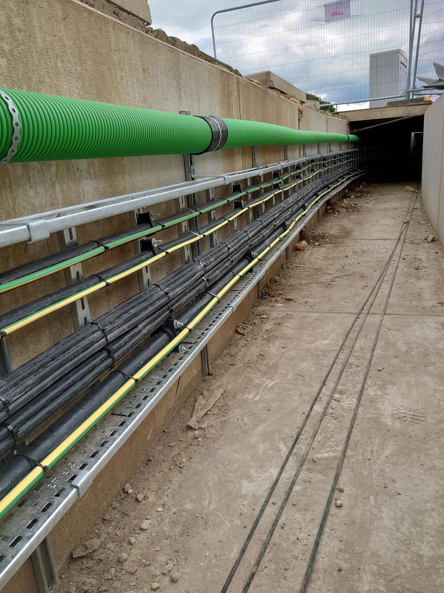
Kent science park submains and containment package

Slide 6
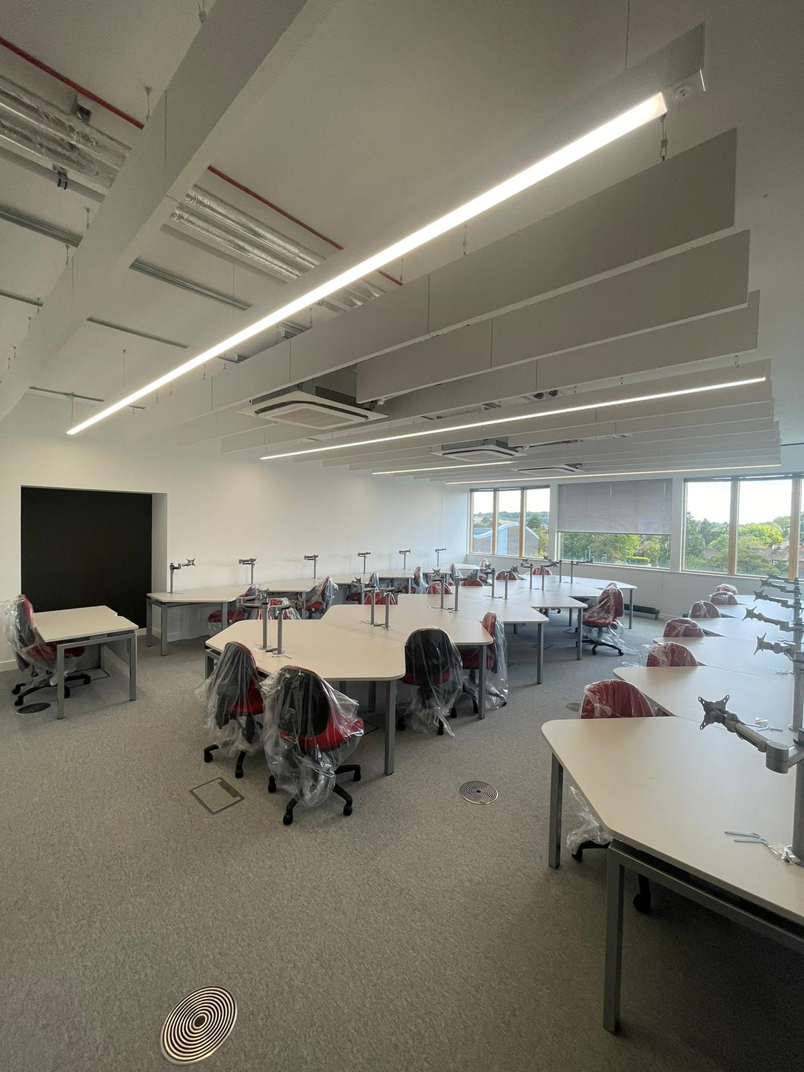
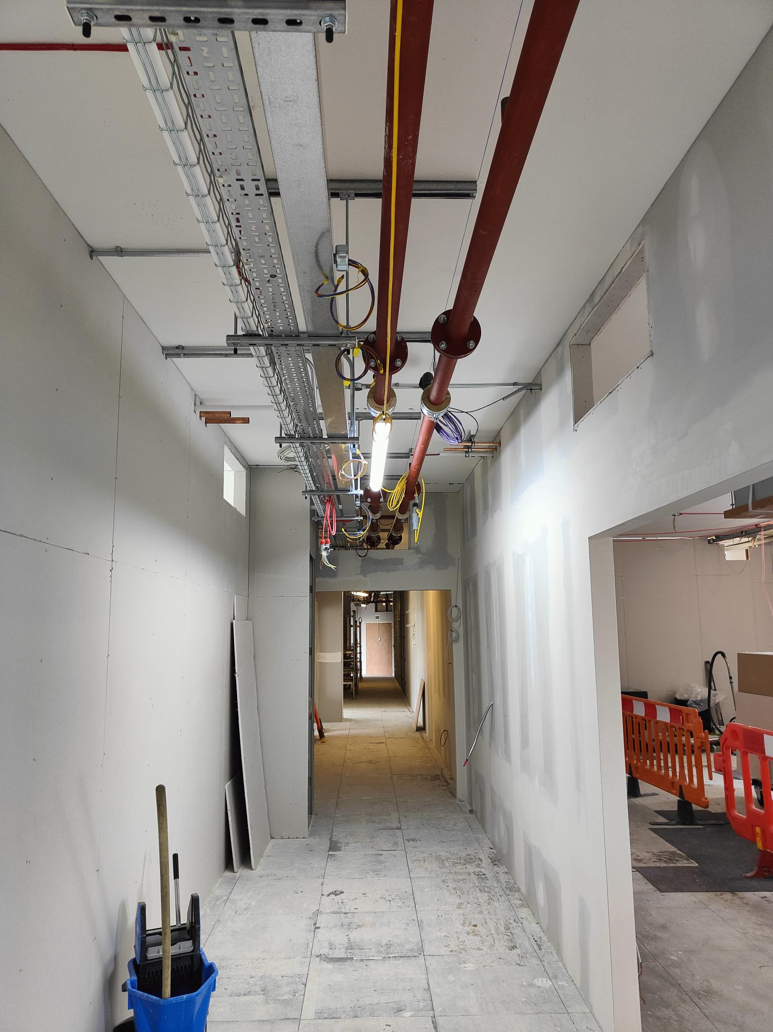
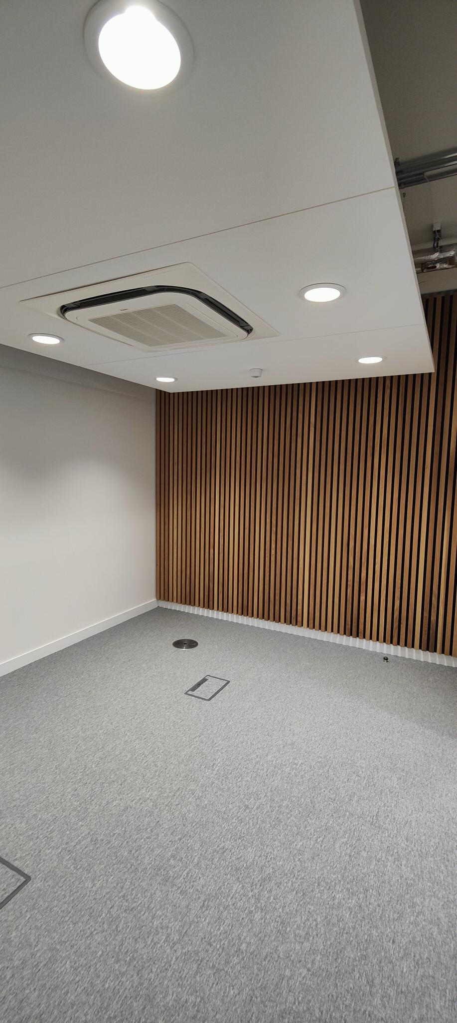
East surrey collage t level teaching area.

